Slide 1
Category review: Chips
June 2020
Retail Analytics
Brand note: If client logo is not required, use alternate title page layout right click slide thumbnail > Layout > Title

Slide 2
Notes:
To view Privacy video explaining how important data privacy is to Quantium, please click here: https://www.youtube.com/watch?v=Zq1QDAkoRzU
or here Q:\Company Reference\Brand & Design\Brand videos\Q Privacy.mp4
At Quantium, we believe that data is the behavioural footprint of humanity and that it has to be treated with the utmost care and responsibility.
Histories, attitudes, indeed lives are stored within it in ways that aren’t always apparent – and that’s what makes its potential so powerful.
To work with it responsibly, sensitively, we set ourselves the highest data privacy protection and governance standards.
We have spent 17 years perfecting privacy-by-design and secure-by-design principles. Central to this is not holding any personally identifiable information about people –
we neither receive it, and put the necessary protections in place to be unable to decipher it.
Every aspect of handling data is safeguarded: from its de-identification, to its encryption – data security is paramount and of the highest grade.
We pride ourselves on gaining the trust of iconic organisations around the world through years of securely working with their data,
and in turn the trust that builds with their stakeholders.

Slide 3
Executive summary
01
Task 1
Chips transactions sales increase substantially in December before Christmas.
Dips in sales were observed during Aug 2018 and May 2019.
Older and Young Families have the highest average purchase unit per unique customer
Highest sales were observed generally for those who were not premium customers. The biggest sales of all were from Older Families – Budget, Young Singles/Couples – Mainstream and Retirees – Mainstream.
02
Task 2
Trial stores 77 and 88 experienced significant increases in total sales and customers during the trial period compared to their respective controls
Trial store 86 also experienced increase, but insignificant compared to its control.

Slide 4
01
Category

Slide 5
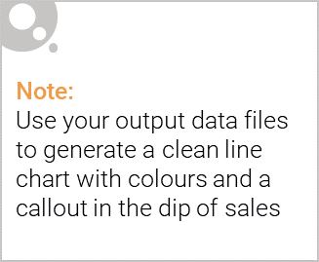
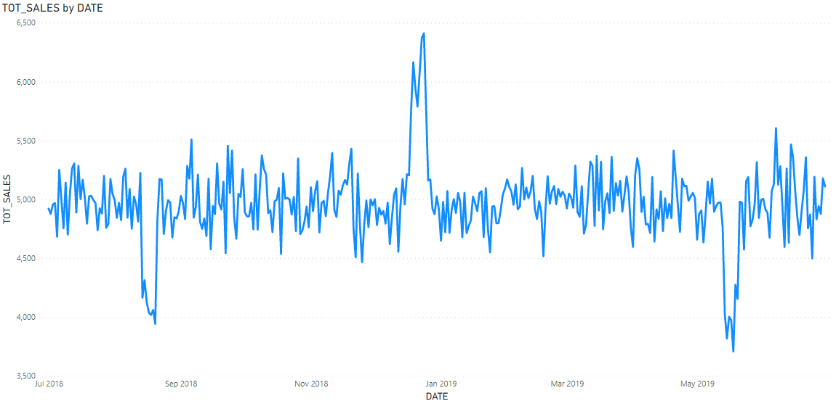
Looking at this graph, we see dips in sale during Aug 2018 and May 2019. We also observe a peak in sales in Dec 2018 (which we can attribute to Christmas sales).

Slide 6
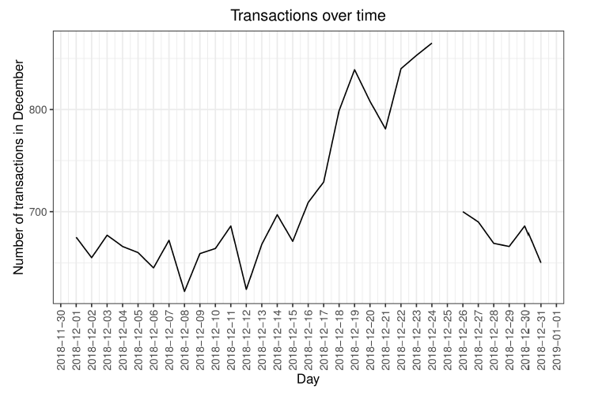
Looking at December 2018, observe that there were no transactions made on December 25 (Christmas Day – non-operational), so no sales were made that day.

Slide 7

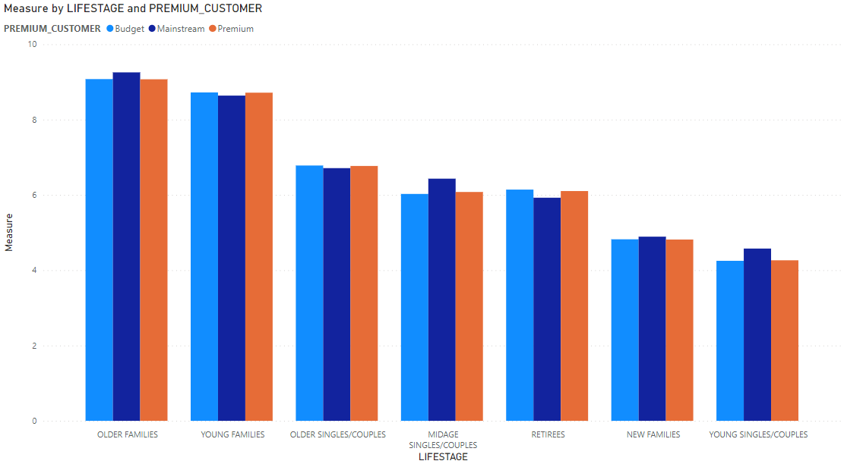
Affluence doesn’t seem to have a significant effect on the quantity of purchase per customer. Older and Young Families show to have the highest average purchase units per unique customer.

Slide 8
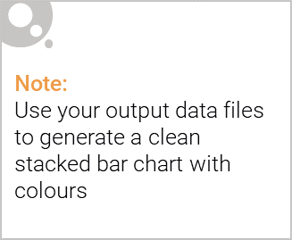
Editable (delete this)
Largest Total Sales by Lifestage and Customer Type were Older Families – Budget, Young Singles/Couples – Mainstream and Retirees – Mainstream. Non-premium customers had more sales than premium customers. In general, older people generated more sales than younger people.

Slide 9
02
Trial store performance

Slide 10
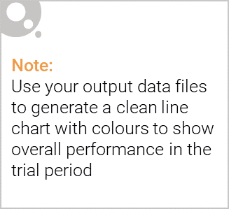
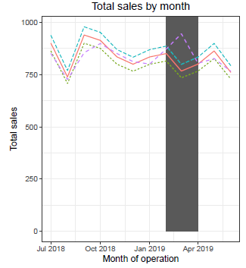
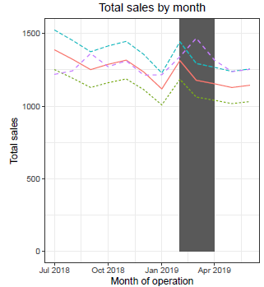
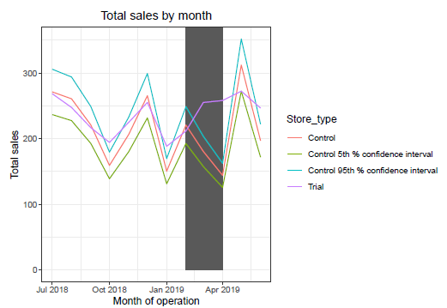
Trial stores 77 & 88 showed significantly different results compared to their respective control stores in the trial period as the trial stores’ performance lied outside the 90% confidence interval of the control store for two of the three months.
However, trial store 86 did not produce any significantly different results.
Store 86
Store 88
Store 77

Slide 11
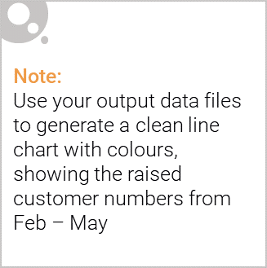
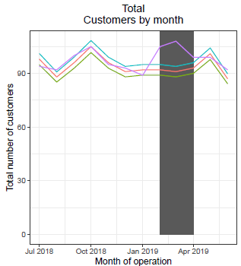
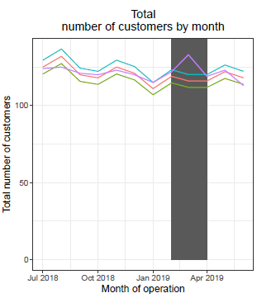
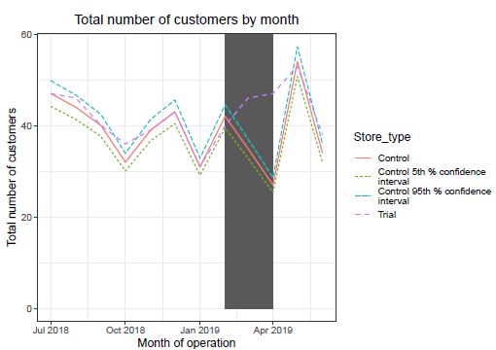
Trial stores 77 & 88 showed significantly different results compared to their respective control stores in the trial period as the trial store performance lies outside the 90% confidence interval of the control store for two of the three months. However, trial store 86 did not produce significantly different results.
Store 86
Store 88
Store 77

